Slide 1

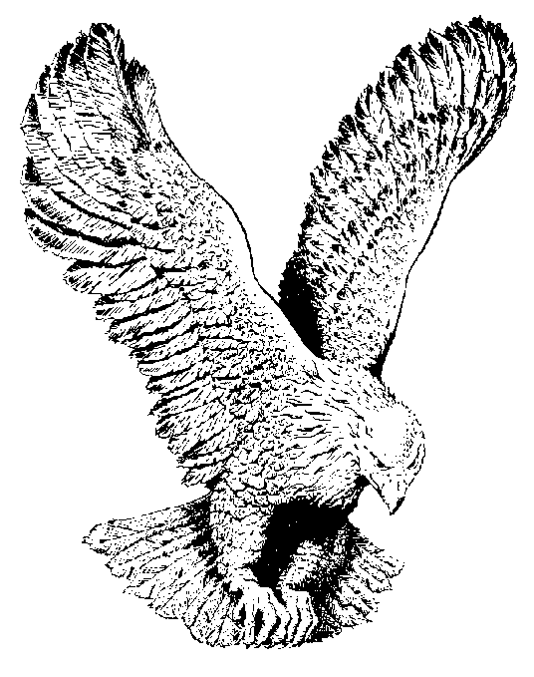
AND IT CAN BE THAT I SHOULD GAIN
And can it be that I should gain
An interest in the Savior’s blood
Died He for me, who caused His pain
For me, who Him to death pursued?
Amazing love! How can it be
That Thou, my God, shouldst die for me?
Amazing love! How can it be
That Thou, my God, shouldst die for me?

Slide 2
He left His Father’s throne above
So free, so infinite His grace
Emptied Himself of all but love
And bled for Adam’s helpless race
‘Tis mercy all, immense and free
For O my God, it found out me!
Amazing love! How can it be,
That Thou, my God, shoudlst die for me?

Slide 3
Long my imprisoned spirit lay,
Fast bound in sin and nature’s night
Thine eye diffused a quickening ray
I woke, the dungeon flamed with light
My chains fell off, my heart was free
I rose, went forth, and followed Thee
Amazing love! How can it be
That Thou, my God shouldst die for me?

Slide 4
No condemnation now I dread
Jesus, and all in Him, is mine
Alive in Him, my living Head
And clothed in righteousness divine
Bold I approach the eternal throne
And claim the crown, through Christ my own
Amazing love! How can it be
That Thou my God, shouldst die for me?

